Slide 1

Glenn High School
Student Engagement
Covid-19
Social Studies, Science, ELA, and Math
March 23, 2020 - May 29, 2020

Slide 2
Objective
Compare student engagement from mid-March through the end of May.
Compare engagement levels by grade-level and departments.
Did overall engagement increase or decrease over time?

Slide 3
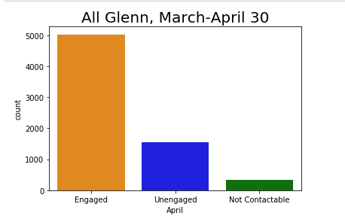
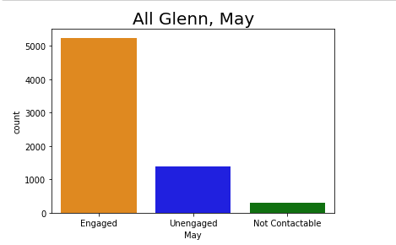
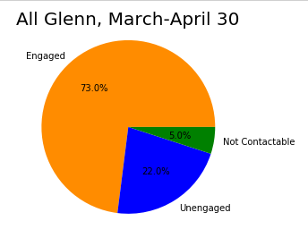
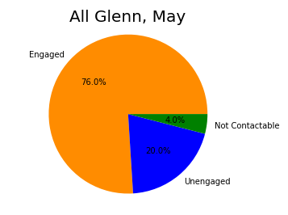
ALL GLENN
Engagement increased from 73% to 76% overall at Glenn.

Slide 4
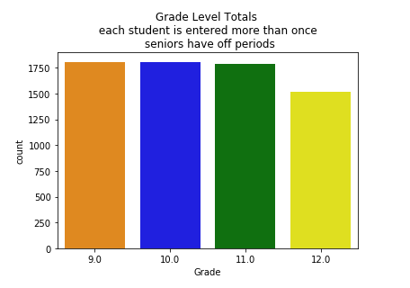

Grade Level
Class size numbers are very similar as expected.
Note: Students are counted in each subject area.
Seniors have off periods.

Slide 5
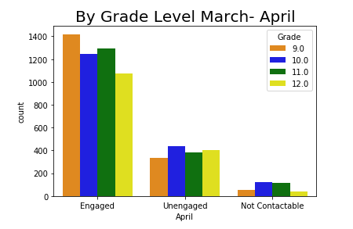
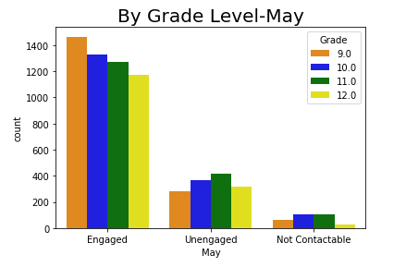
Grade Level
9th grade stayed strong the entire time
10th and 11th changed positions
12th grade has less data so their totals are less.

Slide 6
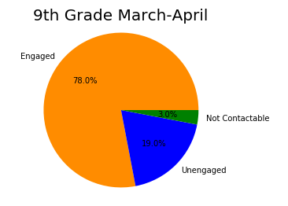
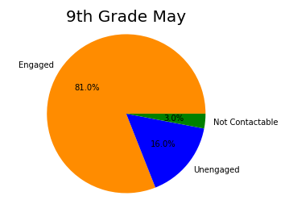
Freshmen
Freshmen increased engagement by 3% and maintained a low 3% not contactable

Slide 7
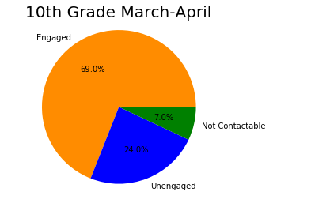
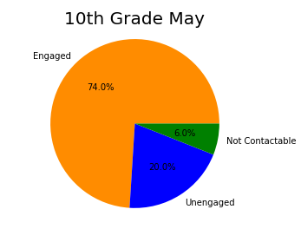
Sophomores
Sophomores had the lowest engagement to start. Engagement increased by 5%.

Slide 8
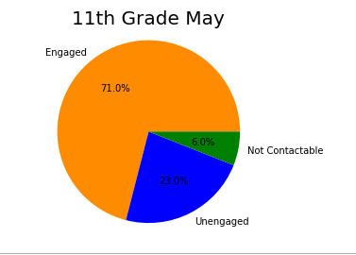
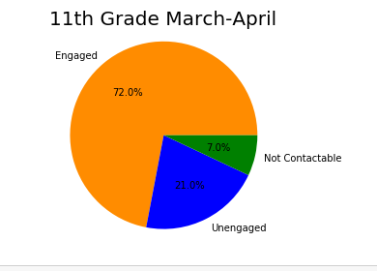
Juniors
Juniors increased engagement by 1%.

Slide 9
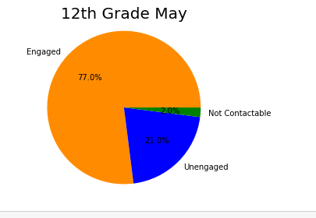
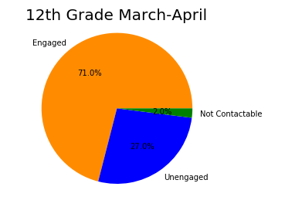
Seniors
It’s not a surprise that Senior engagement decreased at the end of the year. On the positive, Seniors had the smallest number of “Not Contactable” during both time periods. Seniors were #1 in communicating with their teachers.

Slide 10
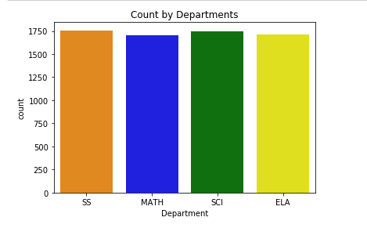

By Departments
ELA, Math, Social Studies, and Science
Departments had roughly the same number of student data points.

Slide 11
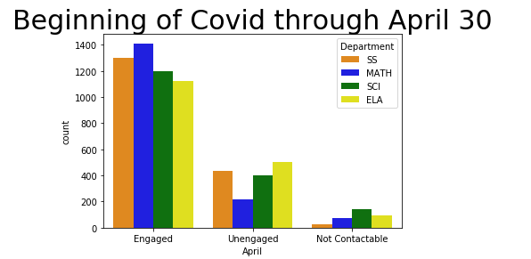
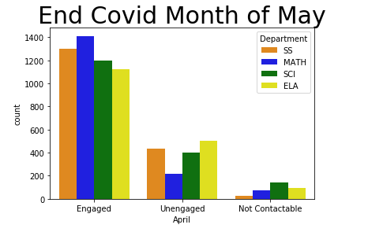

Departments
HEADLINE: MATH LEADS THE WAY
APRIL AND MAY!

Slide 12
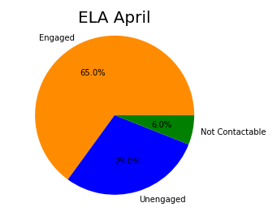
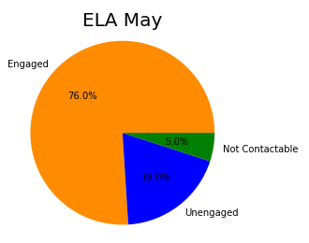
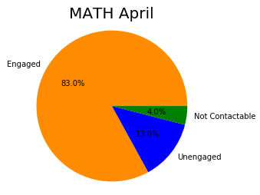
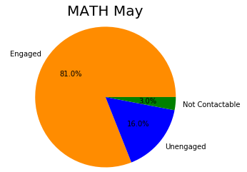
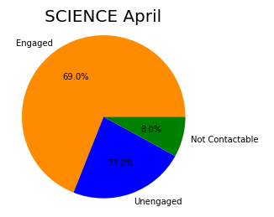
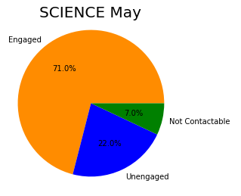
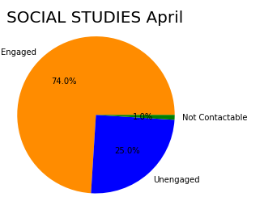
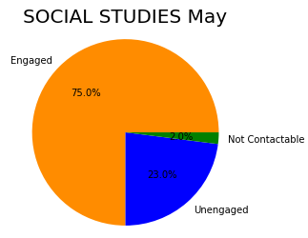
ELA increased by 11%
Math decreased by 2%
Science increased by 2%
Social Science increase by 1%

Slide 13

Questions?
Thank you.

